Slide 1

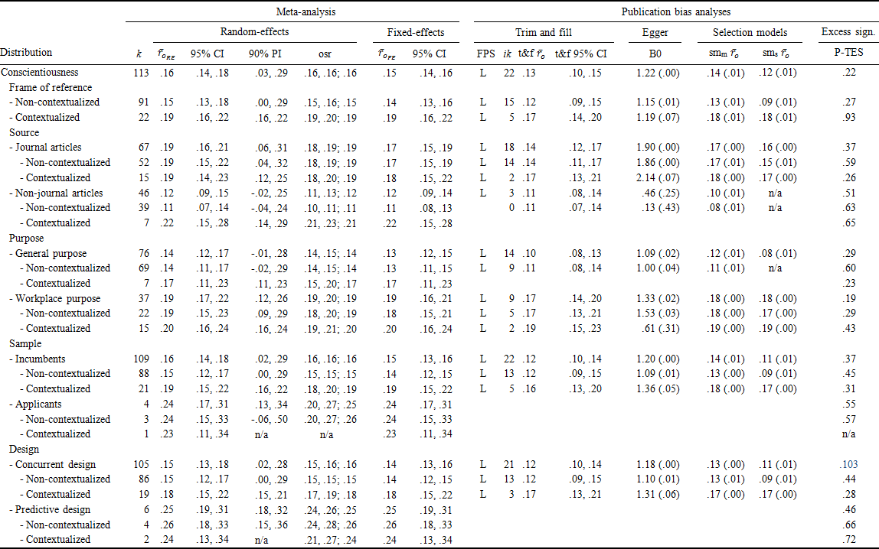
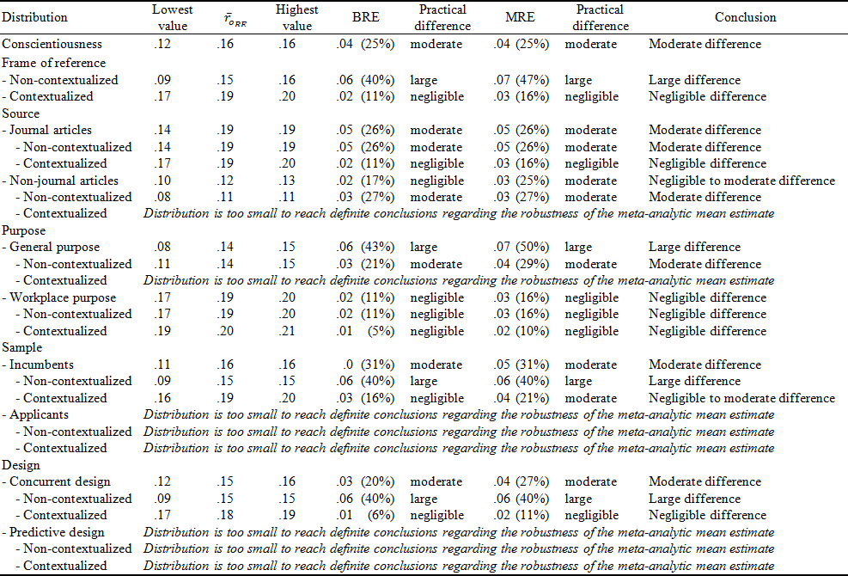
The Validity of Conscientiousness is Overestimated
Sven Kepes and Michael A. McDaniel
Introduction
Meta-analytic findings are viewed as a primary means for generating cumulative knowledge and bridging the often lamented gap between research and practice.
Concerns regarding meta-analytic results and our cumulative knowledge exist.
Sensitivity analyses:
Sensitivity analyses in the context of meta-analysis concern the degree to which the results and conclusions of a meta-analysis remain stable when conditions of the data or the analysis change (Greenhouse & Iyengar, 2009).
To the extent that results and conclusions remain stable, they can be considered robust.
Current study
Analyses were conducted to assess the robustness of the validity of conscientiousness.
Method
Data source: Shaffer and Postlethwaite (2012).
Publication bias analyses:
Trim and fill analysis
Contour-enhanced funnel plots
Cumulative meta-analysis by precision
Selection models (moderate and severe one-tailed)
Egger’s test of the intercept
Test of excess significance
Outlier analysis:
One-sample removed analysis
Results
The validity of conscientiousness is overestimated by around 20%.
This overestimation is likely due to suppression of (a) low validity estimates in non-contextualized conscientiousness measures; (b) low validity estimates in journal articles.
Meta-analytic and publication bias results:
Robustness of results and conclusions of the analyses:
Contour-enhanced funnel plots and forest plots (examples)
Data from journal articles Data from journal articles
Data from non-journal sources
Discussion
The validity of conscientiousness is overestimated (by around 20%). The overestimation is primarily due to publication bias in data from journal articles and non-contextualized measures.
For conscientiousness, results reported in journals and results based on non-contextualized measures may not be trustworthy.
Our journal publication process is in need of revision.
The findings illustrate the need for a rigorous quantitative assessment of the robustness of meta-analytic results.
We encourage the use of sensitivity analyses in all meta-analytic reviews.
Aligned with the approach of triangulation and customer-centric science, we recommend the reporting of the range of results..
N_{cum} Cumulative point estimate

